Slide 1


Structured Analysis
Chapter Four

Slide 2
Structured Analysis
Let us see few analysis and design tools used by software designers:
Data Flow Diagrams
Data Dictionary
Decision Trees
Decision Tables

Slide 3
Data flow Diagram
DFD is graphical representation/model of flow of data in an information system.
It is capable of depicting incoming data flow, outgoing data flow and stored data.
Data Flow Diagrams types.
Logical DFD -
It concentrates on the system process, and flow of data in the system.
Physical DFD -
shows how the data flow is actually implemented in the system.
It is more specific and close to the implementation.

Slide 4
Data flow diagram
DFD Components
Entities -
Entities are source and destination of information data.
Entities are represented by a rectangles with their respective names.
Process -
Activities and action taken on the data are represented by Circle or Round-edged rectangles.
Data Storage -
A location where data is saved to or retrieved from , such as a data base
Data Flow -
Movement of data is shown by pointed arrows.
Data movement is shown from the base of arrow as its source towards head of the arrow as destination.

Slide 5
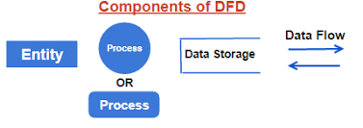
Data flow diagram
DFD Components : Graphical representation

Slide 6
Data flow diagram
Levels of DFD
Level 0 -
it is the highest abstraction level which depicts the entire information system as one diagram hiding all the underlying details.
they are also known as context level DFDs.

Slide 7
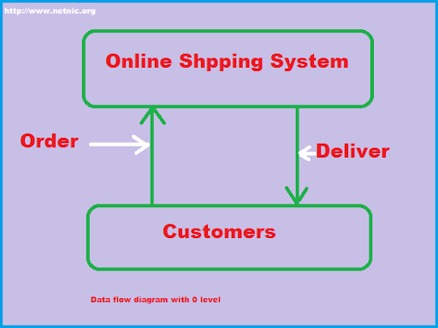
Data flow diagram
Levels of DFD
level 0 can be as easy as the following ecommerce App diagram :

Slide 8
Data flow diagram
Levels of DFD
Level 1 -
The Level 0 DFD is broken down into more specific, Level 1 DFD.
Level 1 DFD shows basic modules in the system and flow of data among various modules.
It also mentions basic processes and sources of information.

Slide 9
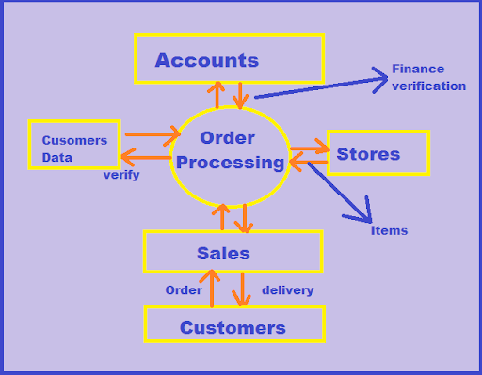
Data flow diagram
Level 1 illustration for the previous ecommerce App.

Slide 10
Data flow diagram
Levels of DFD
Level 2 -
At this level, DFD shows how data flows inside the modules mentioned in Level 1.
Higher level DFDs can be transformed into more specific lower level DFDs
with deeper level of understanding unless the desired level of specification is achieved.

Slide 11
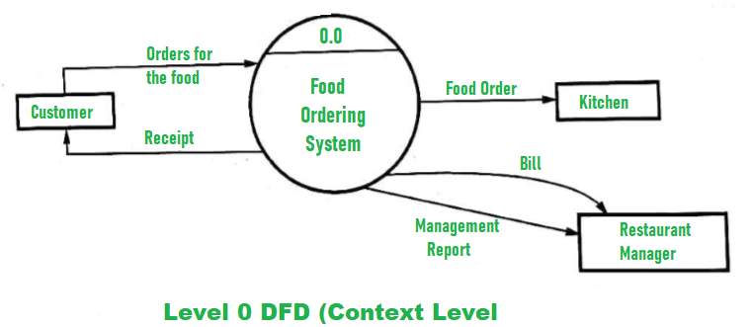
Example
Assume you have Food Ordering System
Level 0 DFD
At this level, the Input and Output of the system are shown.
The system is designed and established across the world with input and output at this level.

Slide 12
Example
Assume you have Food Ordering System
Level 0 DFD
Food Ordering System has the following input :
Food order is input as the customer’s order for food.
Food Ordering System has the following output:
Receipt of the order.
For further processing the order, the food order is passed to the kitchen.
The restaurant manager gets the report of Bill and Management.

Slide 13
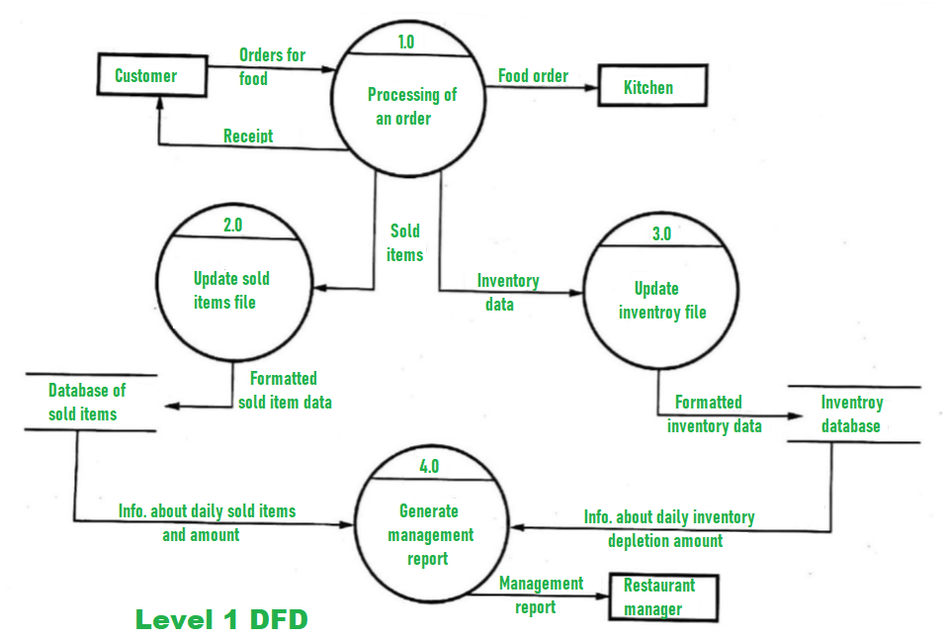
Example
Assume you have Food Ordering System
Level 1 DFD –

Slide 14
Example
Assume you have Food Ordering System
Level 1 DFD –
For processing the order, process 1.0 is responsible.
For food, the housekeeping activities involved are represented by processes 2.0, 3.0, and 4.0.
The detailed information about daily sold items should be available to create and report management and
The list of items that are available ‘in-stock’ should be kept by maintaining the inventory data (describes the records of datasets such as their name, their content, source, many useful information, etc.) at the same time.
Hence, two data stores are used in this level of DFD which are given below :
Database of Sold items
Inventory database

Slide 15
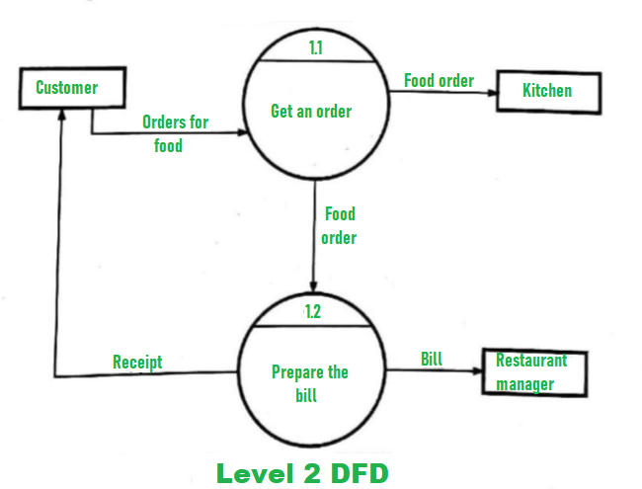
Example
Assume you have Food Ordering System
Level 2 DFD –
Detailed information about “Processing of an Order” is shown below

Slide 16
Data dictionary
A data dictionary is a structured repository of data elements in the system.
It stores the descriptions of all DFD data elements that is,
details and definitions of data flows, data stores, data stored in data stores, and the processes.
A data dictionary improves the communication between the analyst and the user

Slide 17
Data dictionary
Data Dictionary Contents
Data dictionaries contain:
Data flow.
Data structures.
Elements.
Data stores

Slide 18
Data dictionary
Data Dictionary Contents
Data Flow
Each data flow should be defined with descriptive information and its composite structure or elements.
It Includes the following information
ID - identification number, Label, the text that should appear on the diagram.
A general description of the data flow.
The source of the data flow
This could be an external entity,
a process, or a data flow coming from a data store.
The destination of the data flow

Slide 19
Data dictionary
Data Dictionary Contents
Data Flow
Data flow Include the following information
Type of data flow, either:
A record entering or leaving a file.
Containing a report, form, or screen or
Internal used between processes.
The name of the data structure or elements
The volume per unit time
This could be records per day or any other unit of time.
An area for further comments and notations about the data flow

Slide 20
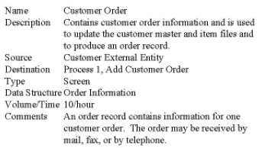
Data dictionary
Data Dictionary Contents
Data Flow
Example

Slide 21
Data dictionary
Data Dictionary Contents
Data Structures
Data structures are a group of smaller structures and elements.
An algebraic notation is used to represent the data structure.
The symbols used are:
Equal sign, meaning “consists of”.
Plus sign, meaning "and”.
Braces {} meaning repetitive elements, a repeating element or group of elements.
Brackets [] for an either/or situation.
The elements listed inside are mutually exclusive.
Parentheses () for an optional element.

Slide 22
Data dictionary
Data Dictionary Contents
Data Structures
Repeating Groups
A repeating group may be:
A sub-form.
A screen or form table.
A program table, matrix, or array.
There may be one repeating element or several within the group.

Slide 23
Data dictionary
Data Dictionary Contents
Data Structures
The repeating group may have:
Conditions.
A fixed number of repetitions.
Upper and lower limits for the number of repetitions.

Slide 24
Data dictionary
Data Dictionary Contents
Data Structures
Data structures may be either logical or physical.
Logical data structures indicate the composition of the data familiar to the user.
Physical Data Structures Include
elements and information necessary to implement the system
Key fields used to locate records.
Codes to indicate record status.
Codes to identify records when multiple record types exist on a single file.
A count of repeating group entries.

Slide 25
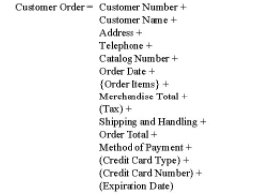
Data dictionary
Data Dictionary Contents
Data Structures
Example

Slide 26
Data dictionary
Data Dictionary Contents
Data Structures
Structural Records
A structure may consist of elements or smaller structural records.
These are a group of fields, such as:
Customer Name, Address, Telephone.
Each of these must be further defined until only elements remain.

Slide 27
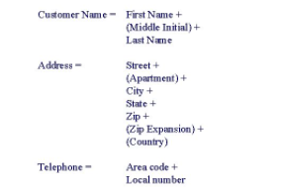
Data dictionary
Data Dictionary Contents
Data Structures
Structural Records
Example

Slide 28
Data dictionary
Data Dictionary Contents
Elements
Data elements should be defined with descriptive information, length and type of data information, validation criteria, and default values.
Each element should be defined once in the data dictionary.
Attributes of each element are:
Element ID: This is the entry that allows the analyst to build automated data dictionary entries.
The name of the element, descriptive and unique
It should be what the element is commonly called in most programs or by the major user of the element.

Slide 29
Data dictionary
Data Dictionary Contents
Elements
Attributes of each element are:
Aliases, which are synonyms or other names for the element
These are names used by different users within different systems
Example, a Customer Number may be called a
Receivable Account Number or Client Number.

Slide 30
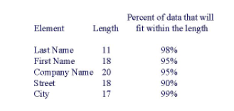
Data dictionary
Data Dictionary Contents
Elements
Attributes of each element are:
A short description of the element
Whether the element is base or derived
A base element is one that has been initially keyed into the system.
A derived element is one that is created by a process, usually as the result of a calculation or some logic.
The length of an element
example

Slide 31
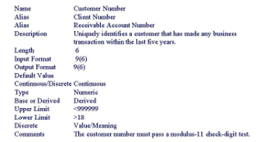
Data dictionary
Data Dictionary Contents
Elements
Example

Slide 32
Data dictionary
Data Dictionary Contents
Data Stores
Data stores contain a minimal of all base elements as well as many derived elements.
Data stores are created for each different data entity; that is, each different person, place, or thing being stored.
Data Store Definition :
The Data Store ID,
The Data Store Name, descriptive and unique
An Alias for the file,
A short description of the data store
The file type, either manual or computerized

Slide 33
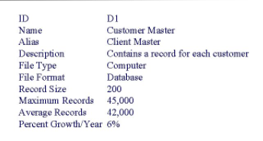
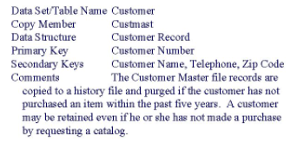
Data dictionary
Data Dictionary Contents
Data Stores
example

Slide 34
Decision tree
Is a method for defining complex relationships by describing decisions and avoiding the problems in communication.
It is a diagram that shows alternative actions and conditions within horizontal tree framework.
Thus, it depicts which conditions to consider first, second, and so on.
Decision trees depict the relationship of each condition and their permissible actions.
A square node indicates an action
A circle indicates a condition.
It forces analysts to consider the sequence of decisions and identifies the actual decision that must be made.

Slide 35
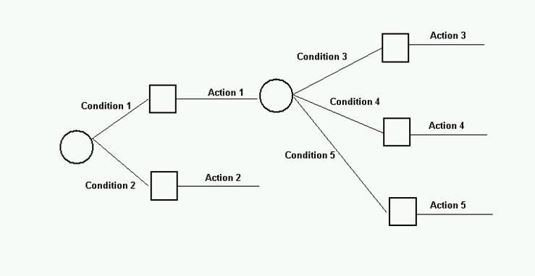
Decision tree
Decision Tree Elements:

Slide 36
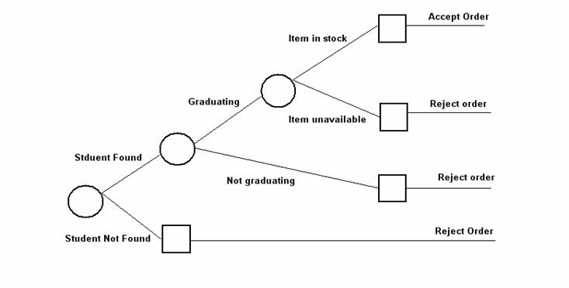
Decision tree
Example
Assume you have An Student Gown ordering system

Slide 37
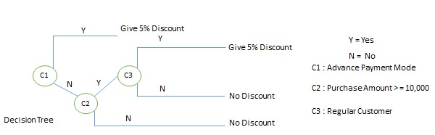
Decision tree
The major limitation of a DT is that it lacks information in its format to describe what other combinations of conditions you can take for testing.
It is a single representation of the relationships between conditions and actions.
For example:

Slide 38
Exercise
Assume a library system and draw a decision tree for it
The library has the following rules/Policy
A Teacher can take a Book for full Semester
A Student can take a Book for two weeks
A Visitor can take a Book for 1 week after deposit a security Amount
If Book is not available then a teacher/student can reserve a book
If there is a delay a student is fined 50birr
If there is a delay a visitor is fined 100birr
The visitor’s security is refunded after returning the book
Delay and fine rule doesn’t apply for teachers

Slide 39
Decision Tables
A method of describing the complex logical relationship in a precise manner which is easily understandable.
It is useful in situations where the resulting actions depend on the occurrence of one or several combinations of independent conditions.
It is a matrix containing row or columns for defining a problem and the actions.

Slide 40
Decision Table
Components of a Decision Table
Condition Stub
It is in the upper left quadrant which lists all the condition to be checked.
Action Stub
It is in the lower left quadrant which outlines all the action to be carried out to meet such condition.
Condition Entry
It is in upper right quadrant which provides answers to questions asked in condition stub quadrant.
Action Entry
It is in lower right quadrant which indicates the appropriate action resulting from the answers to the conditions in the condition entry quadrant.

Slide 41
Decision Table
The entries in decision table are given by decision rules
which define the relationships between combinations of conditions and courses of action.
In rules section
Y shows the existence of a condition.
N represents the condition, which is not satisfied.
A blank - against action states it is to be ignored.
X (or a check mark will do) against action states it is to be carried out.

Slide 42
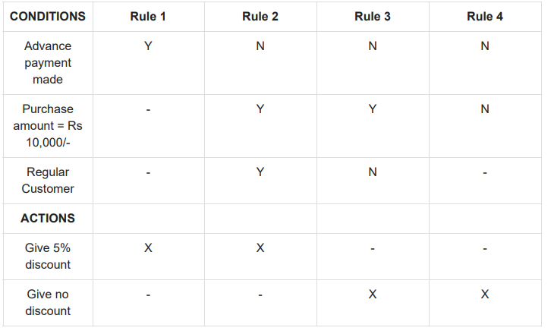
Decision Table
Example:

Slide 43
Exercise
Assume a library system and draw a decision table for it
The library has the following rules/Policy
A Teacher can take a Book for full Semester
A Student can take a Book for two weeks
A Visitor can take a Book for 1 week after deposit a security Amount
If Book is not available then a teacher/student can reserve a book
If there is a delay a student is fined 50birr
If there is a delay a visitor is fined 100birr
The visitor’s security amount is refunded after returning the book
Delay and fine rule doesn’t apply for teachers

Slide 44
Conditions stub | Condition Entry
Teacher | Y | Y | Y | N | N | N | N | N | N | N
Student | N | N | N | Y | Y | Y | Y | N | N | N
Visitor | N | N | N | N | N | N | N | Y | Y | Y
Issue book | Y | N | N | Y | Y | N | N | Y | N | N
Available | Y | N | - | Y | N | - | - | Y | - | -
Return | N | N | Y | N | N | Y | Y | N | Y | Y
Delay | - | - | - | - | - | N | Y | - | Y | N
Action stub | Action Entry
1 week |  |  |  |  |  |  |  | X
2 Week |  |  |  | X
Full Semester | X
Reserve a book |  | X |  |  | X
Pay 50birr refine |  |  |  |  |  |  | X
Pay 100birr refine |  |  |  |  |  |  |  |  | X
Depose security |  |  |  |  |  |  |  | X
Refund security |  |  |  |  |  |  |  |  | X | X
Return book |  |  | X |  |  | X | X |  | X | X
Possible solution for the previous scenario

Slide 45
Go To
Chapter Three
Chapter Two
Chapter One

